Slide 1
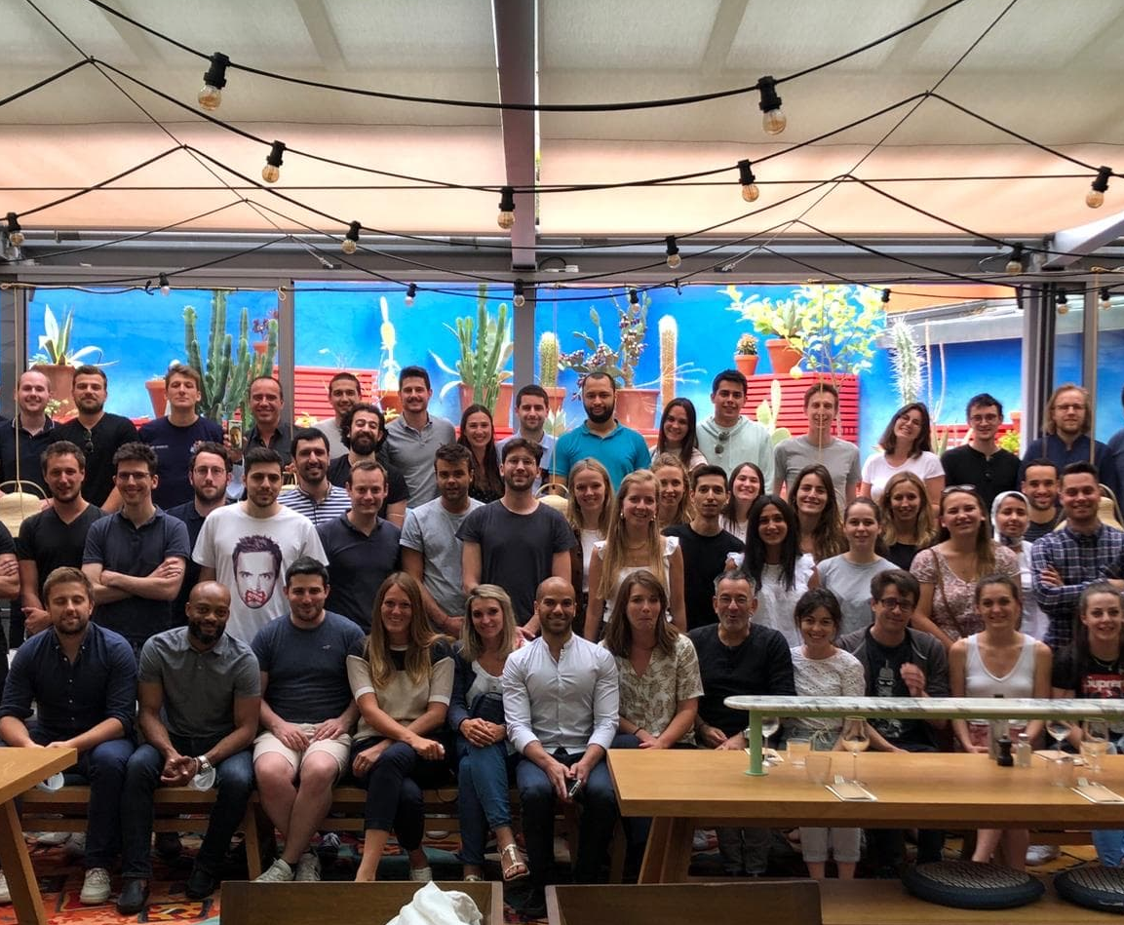


Joseph Pereniguez – Septembre 2020

Slide 2

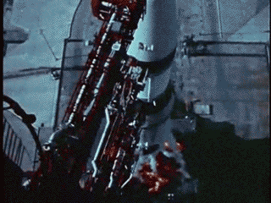

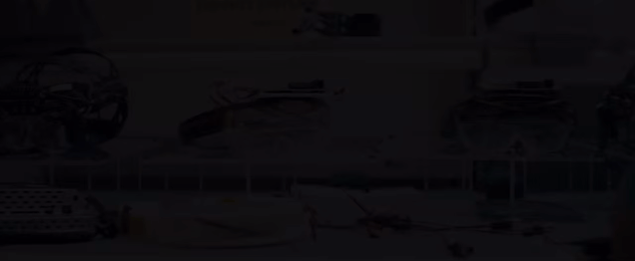
The Company
The Product
Squads & Methodology
My Work & tasks
Notes:
So first I will talk about the company, it’s history and its leaders.
Then I will explain what the Hublo product is,
Thirdly I will introduce the tech team and it’s uncommon methodology
Finally I will talk about my work at Hublo

Slide 3
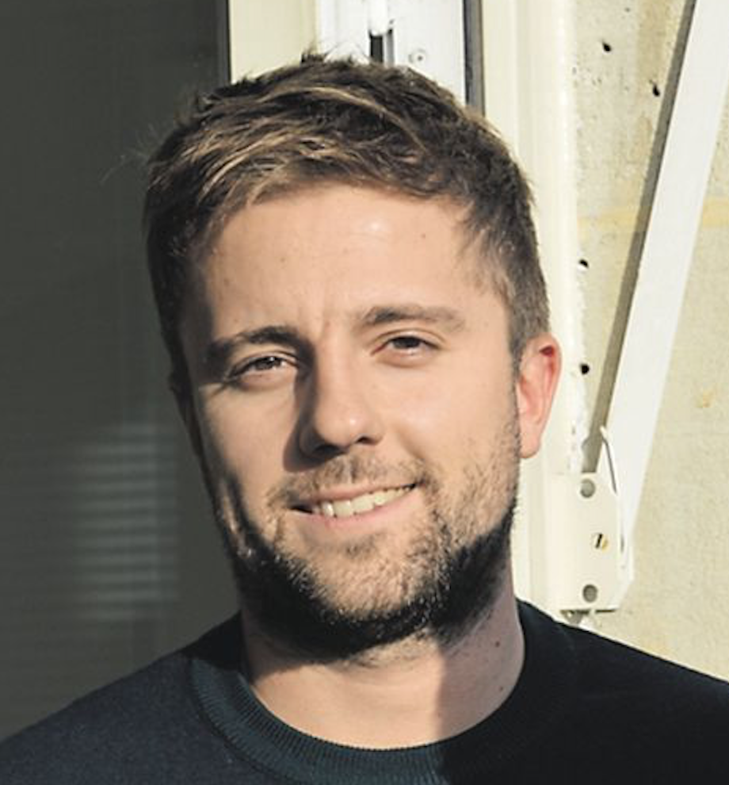
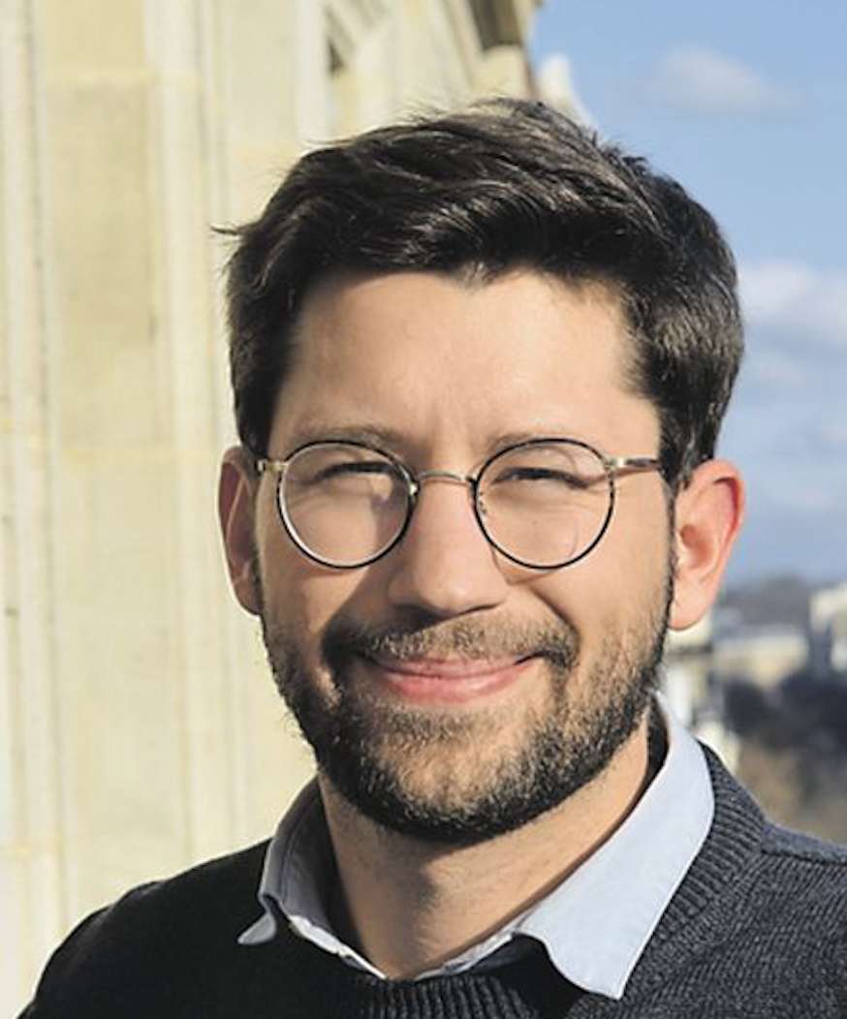


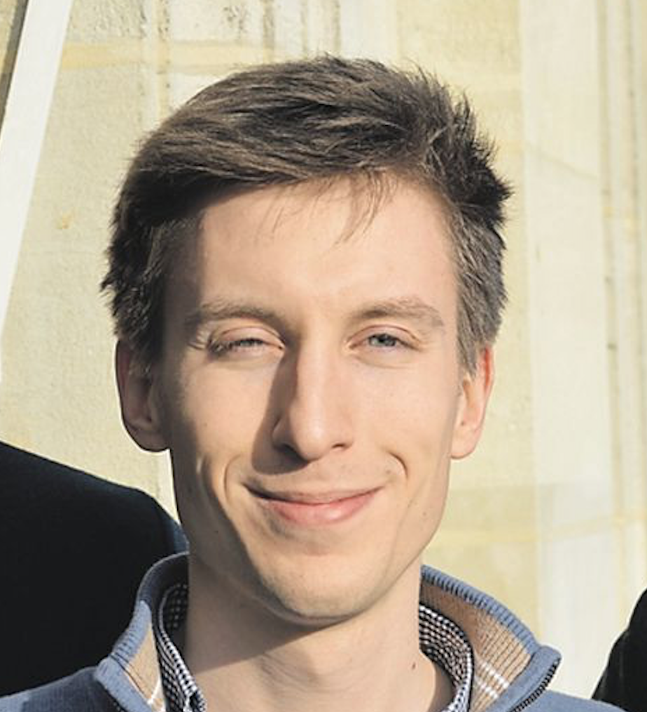

HUBLO – THE COMPANY
Antoine Loron
Adrien Beata
CEO
COO
Chris Rydahl
CTO
Notes:
This internship is not common because at first there were two main company on the market: Whoog and Medgo,
Respectively 3aged company and 5aged company leaded by --- -----
I did an 8 month part-time at Whoog post covid and during the covid crisis then at the end of the confinment the leaders announced the fusion between the companies in order to calm down this price war and to have a solid product.
So we decided to keep the medgo product as a base for the new company: Hublo
Guerric Faurre & Michael Rabaron
Founded by Adrien & Antoine
Chris as CTO
It’s been 10month I’m working with the Hublo team and so I know the 2 old product and the new one.

Slide 4
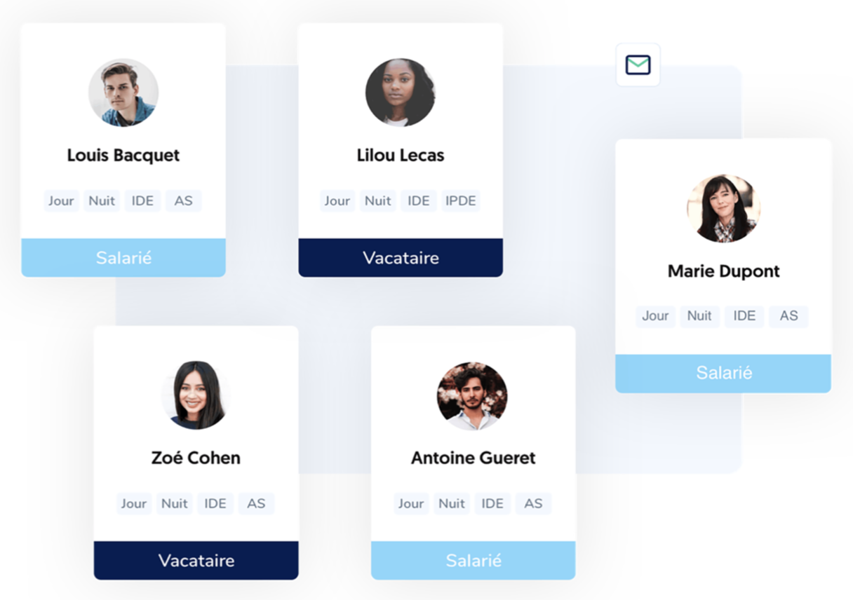
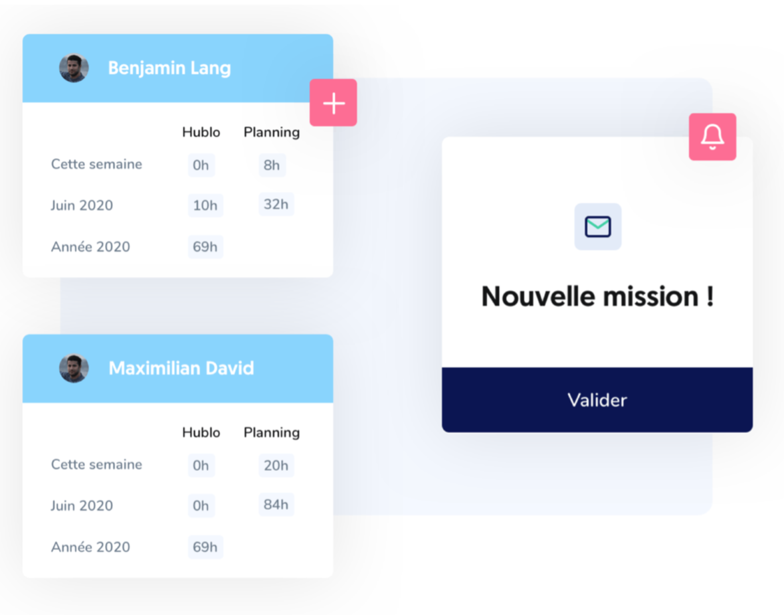


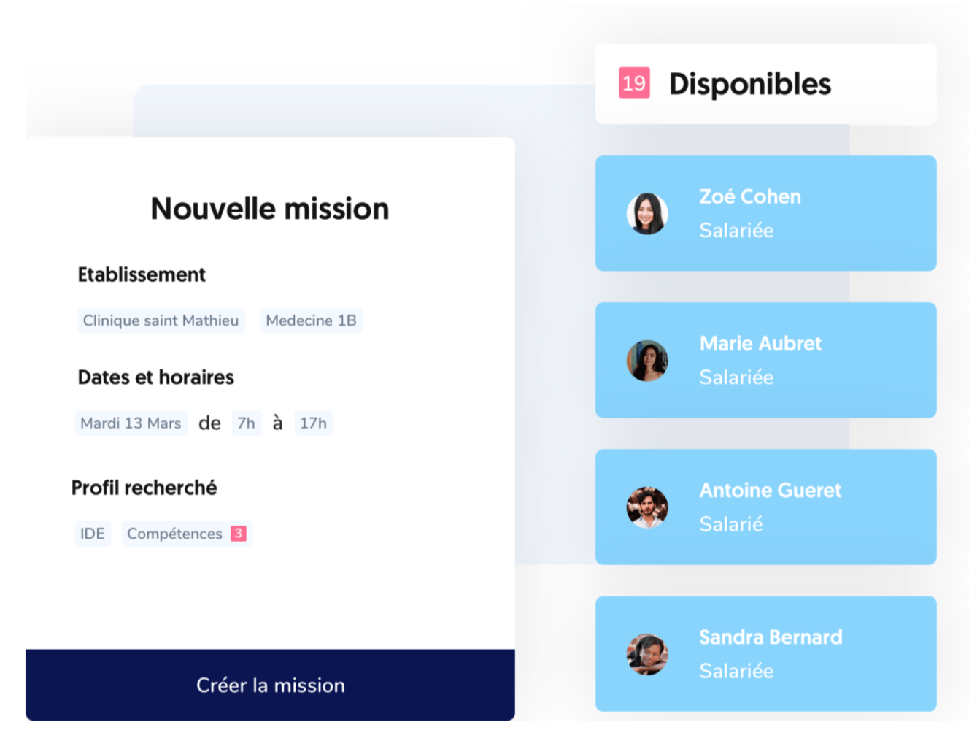
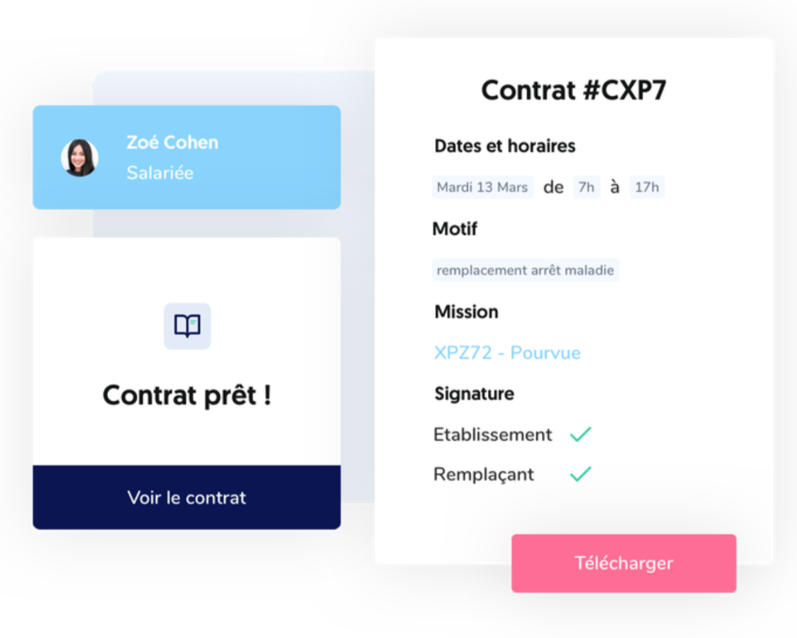
HUBLO – PROBLEM
The management and allocation of replacements is very time consuming and takes 2 hours (~30% of their working time) for supervision and management.
It is sometimes necessary to call on temporary employment agencies, which are very expensive.
Notes:
Hublo starts from 2 observations:
-
-
the solution: Hublo
a web application that facilitates the recruitment of healthcare personnel in France.
But how does hublo work? I will explain it.

Slide 5
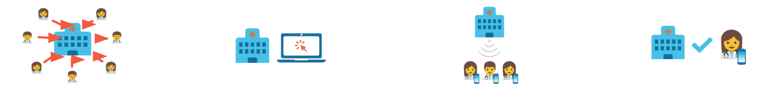
HUBLO – SOLUTION
1
2
3
4
The establishment invites its agents and temporary workers to register volunteers on the platform.
For each need, a health executive posts a mission on the platform in 30 seconds.
Available and eligible workers are instantly alerted by SMS, email and notifications and can apply by replying to the SMS or on the application.
The mission is
assigned by the manager to one of the replacement candidates based on the selection criteria.
Notes:
1 – The healthcare personnel
They can register if they wish to make extras.
2 – HR
They fill a form explaining who is replaced, in which hospital, which service, which job, when… etc
3 – They receive the mission and they can accept it, so it will generate the payroll contract, the mission letter sometimes and other employment documents.
4 – There is an arbitration by the HR so he can attribute or refuse the mission for a specific worker.
According to a survey of 67 customers:
43 min are saved every day on average ...and up to 90 min/day.

Slide 6









HUBLO – SOME CUSTOMERS
Notes:
Here are some very important customers as Hopital européen who have hospitals in Marseilles and Paris for example.
And other important healthcare group as APHM, Ramsay santé and Elsan

Slide 7
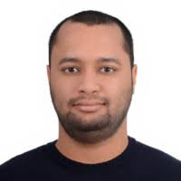


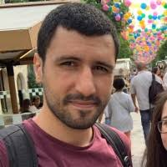


HUBLO – SQUADS & METHODOLOGY
Radhi Nasser
Pierrick Jolly
Axel Mathieu
Khaled Romdhane
Diver
Pitcher
Catcher
Team
rotation
x13
Notes:
Now I’l talk about the tech team of the company:
So first let me introduce the system we use to share the work on the product
We divided the tech team in 4 squads. Each squads have a fixed squad owner, here they are -> lead dev khaled
Our team is composed by 13 dev splitted in these 4 squad, each squads work on a specific part of the product, i’m currently working in the squad 4 under Pierrick order because I work on a the servicebackoffice microservice, i will explain what it is later.
We do not use agile or scrum method to work but a homemade method, have you ever heard about these terms anywhere ?
They are from baseball but today nothing about baseball let me explain.
The diver is working on the conception of a feature, a fix or anything else with products managers and product owners, he write the head lines of the feature and define the scope of an intervention. The diver needs 6 month working with this methodology tobe allowed to do it.
The pitcher follow the instruction from the Diver and its the one who code.
He some some follow up meeting with the diver sometime.
Then when the pitcher’s work is done the catcher (need to be different from the pitcher) will check the work done and send it in production with the CTO validation.
Every developers except the squad owner are mooving in these squad.
I’m particulary prood to be allowed to write diving despite the time I used this methodology, the CTO recognized my ability to design a task.

Slide 8









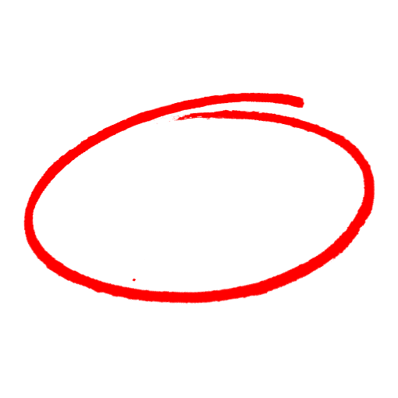
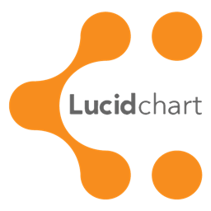

HUBLO – MY TASKS
Monolithic project
Micro-services:
Servicecounter
Servicebackoffice
Servicecontract
Servicenetwork
…
Serviceapi
Notes:
Monolithis project is messy to maintain because every part of the product are at the same place and it’s not easy to work at the same place when you are a 13 people team.
It’s why they decided to split the product in micro-services, part of the product which handle a specific thing for example:
-
-
But every part of the product need data and need to share data with others in order to work
So we needed a serviceapi (the backend of the application, not visual part) to handle this data.
My first task was to create 280 endpoint, and the data structure related to these endpoint to ask to the database specifics things and institutions, admins name…
We used Postman to test them and verify the data is well retrieved.
It took almost one month to do this and i use these tools.

Slide 9




HUBLO – MY TASKS
Features from Whoog:
export the payroll
refuse an mission and access its list of refused missions
Add a test battery for these new features
Develop the Servicebackoffice
Notes:
We choosed to keep the medGo product as a base for our company so we got some missing features
More feature we add we have to test
Pupeteer to use end to end test (tester l’ui/ux des features)
Circle-CI to run some performence test.
Heroku to run environement to test them and show them to product owners and product managers.
develop the servicebackoffice in order to lighten the serviceapp code (the basis of the project)

Slide 10
MERCI !
Notes:
I’m particulary prood of my work at the company because I can bring knowledges from my previous part time and the old product, I improved the product by designing features and really being involved in the product development.
I hope my story will not end at the end of this internship and I’m in negociation with the CTO about that.
The company wants to target other sectors of activity and is in relationship with large groups act as coca cola for the business and I would enjoy participate in this adventure

